Slide 1
Unity 01
CC LAB 2016

Slide 2
What is Unity?
Unity is a game engine.

Slide 3
Game engines are software that make building games easier.

Slide 4
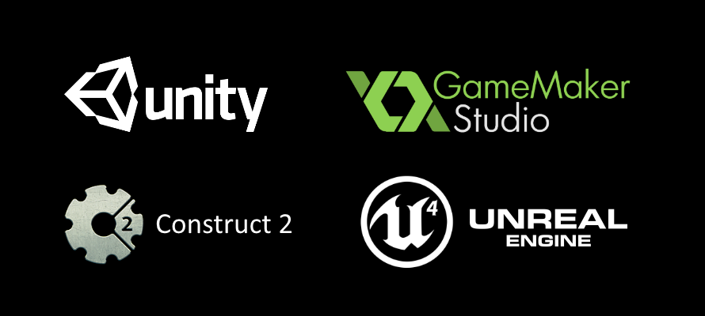
And many more...
Notes:
Some game engines.

Slide 5


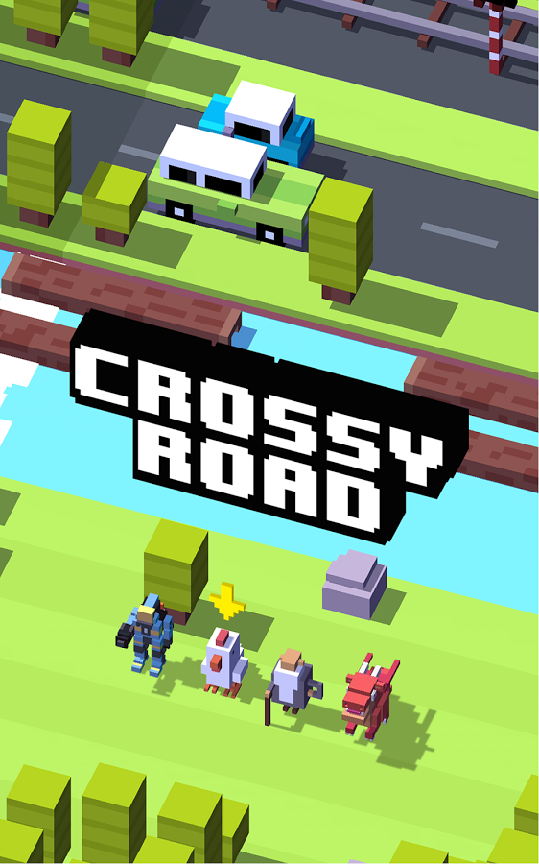

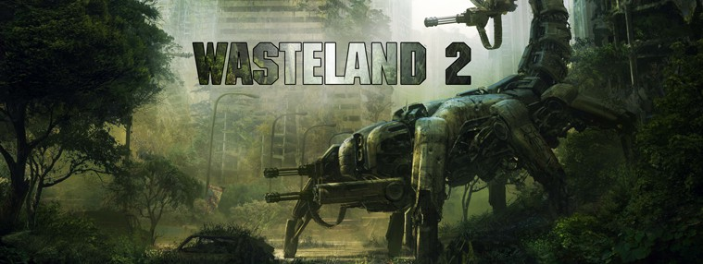

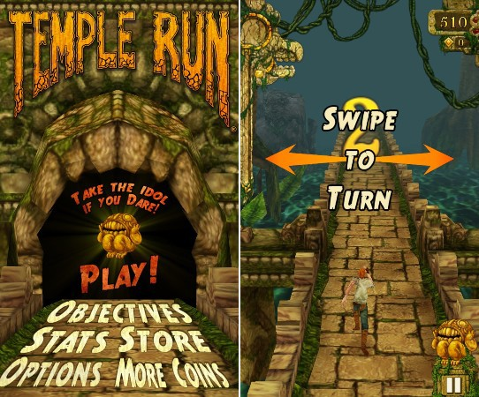
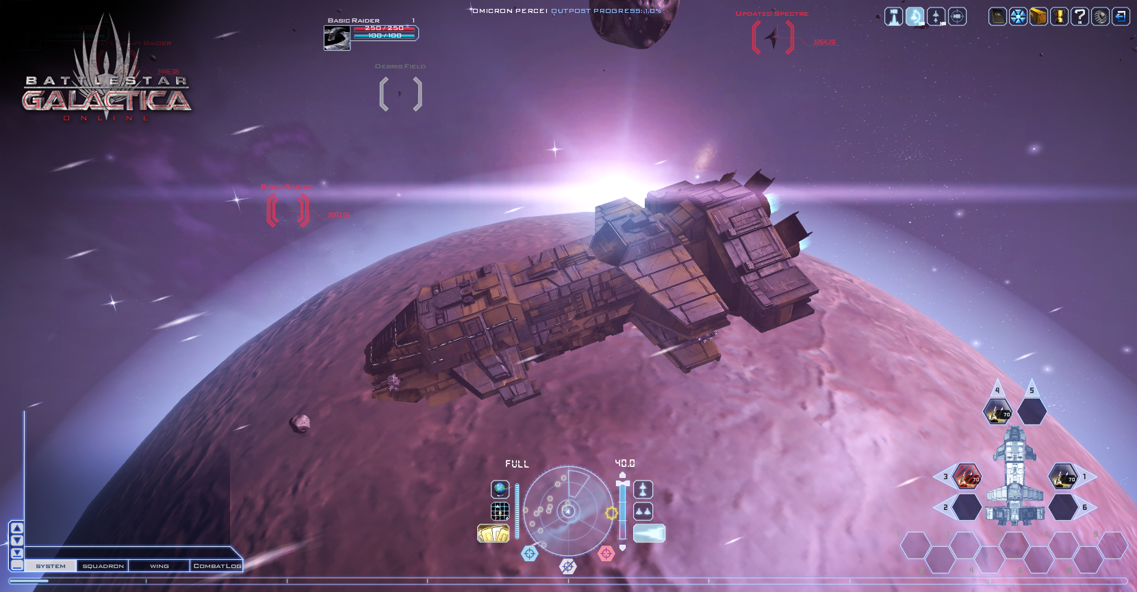
Games built in Unity.
Notes:
Games made with Unity.
More examples: https://unity3d.com/showcase/gallery/games

Slide 6
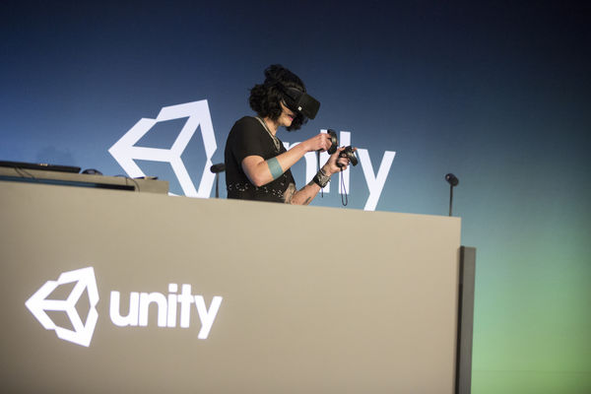

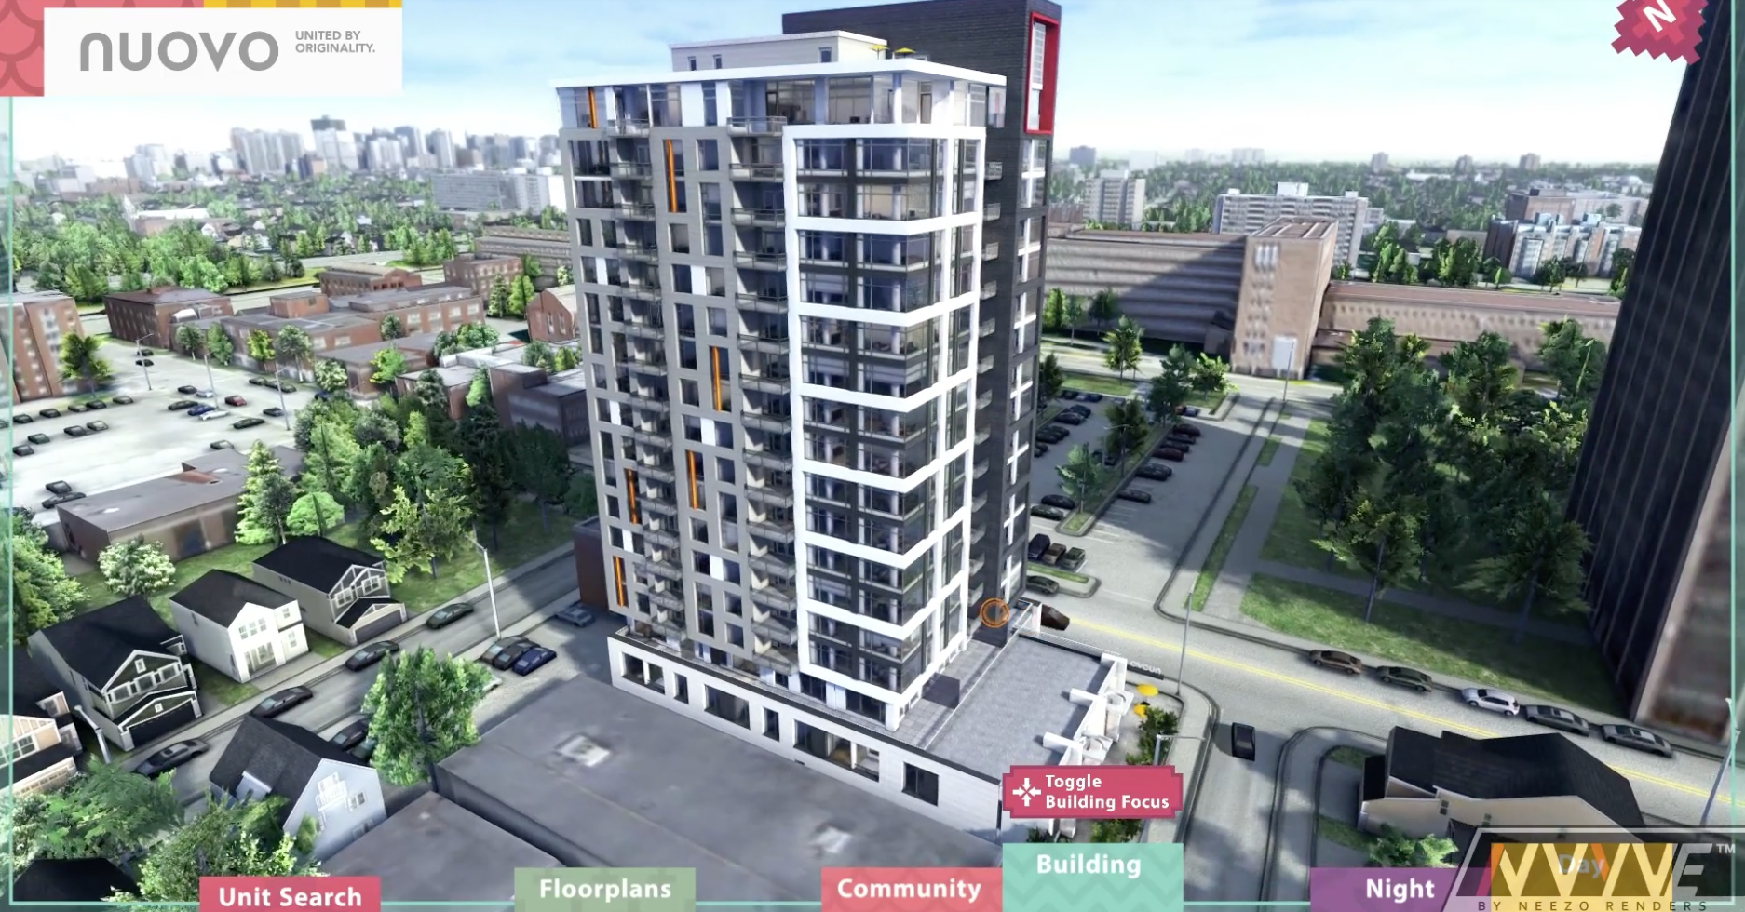

Unity is not just for games.
Nuovo - Condo Visualization
Notes:
Other things you can also do with Unity: build virtual experiences.
You can show them non-game examples: https://unity3d.com/showcase/gallery/non-games

Slide 7

(Let’s get started.)

Slide 8

Unity comes with a lot of documentation:
https://docs.unity3d.com/Manual/index.html

Slide 9
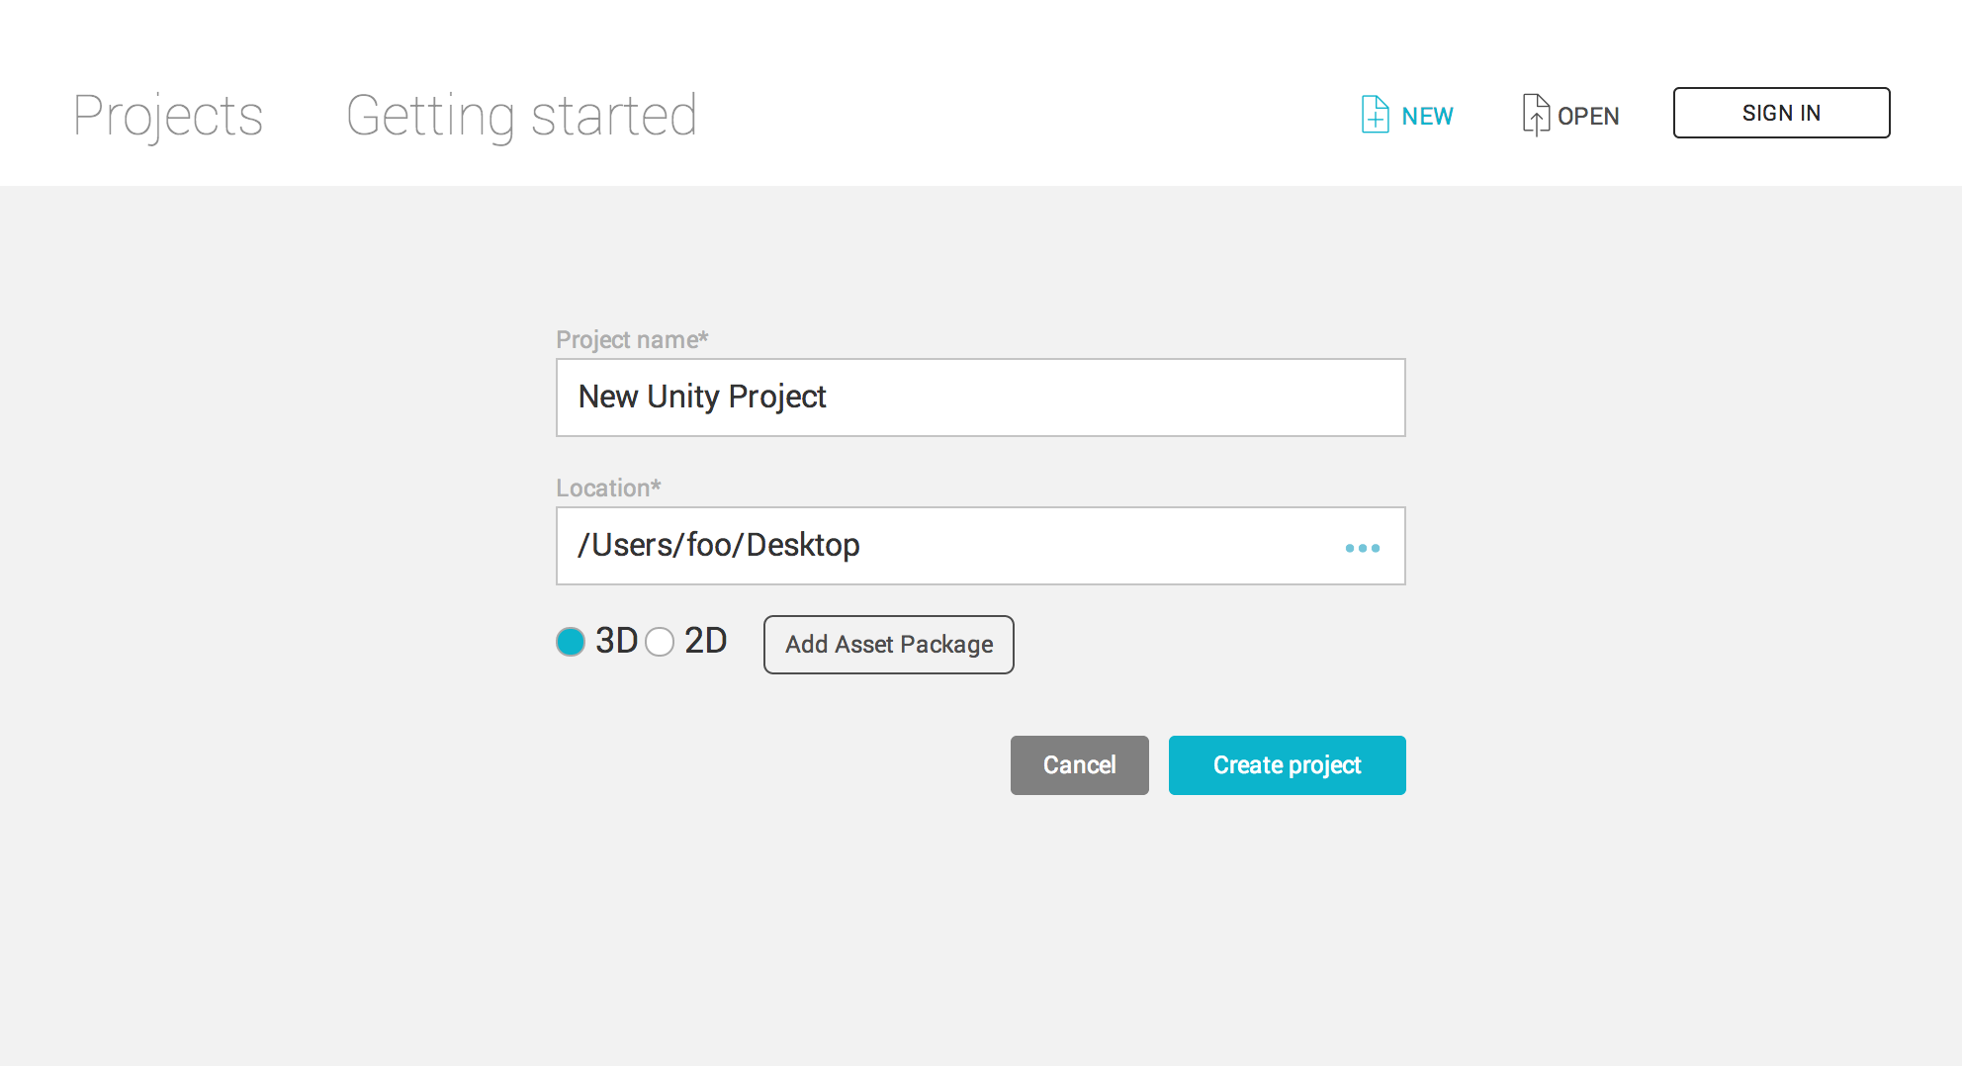
Unity offers support for 3D / 2D game development.

Slide 10
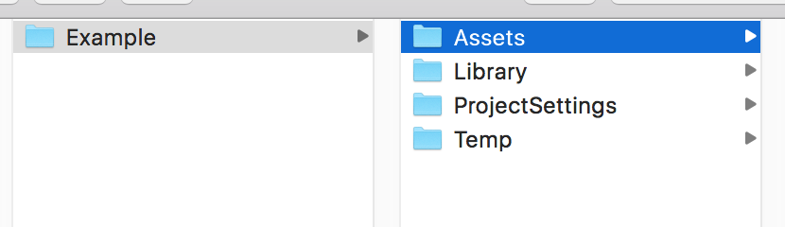
Creating a new project will create four new folders.
Assets is where you’ll put all your game resources in.

Slide 11
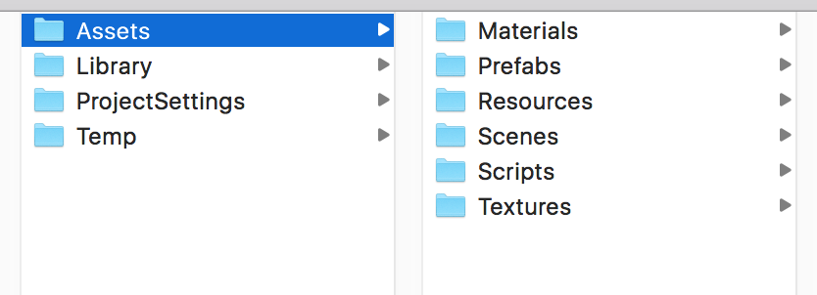
Assets may include scripts, sprites, scenes, etc.

Slide 12
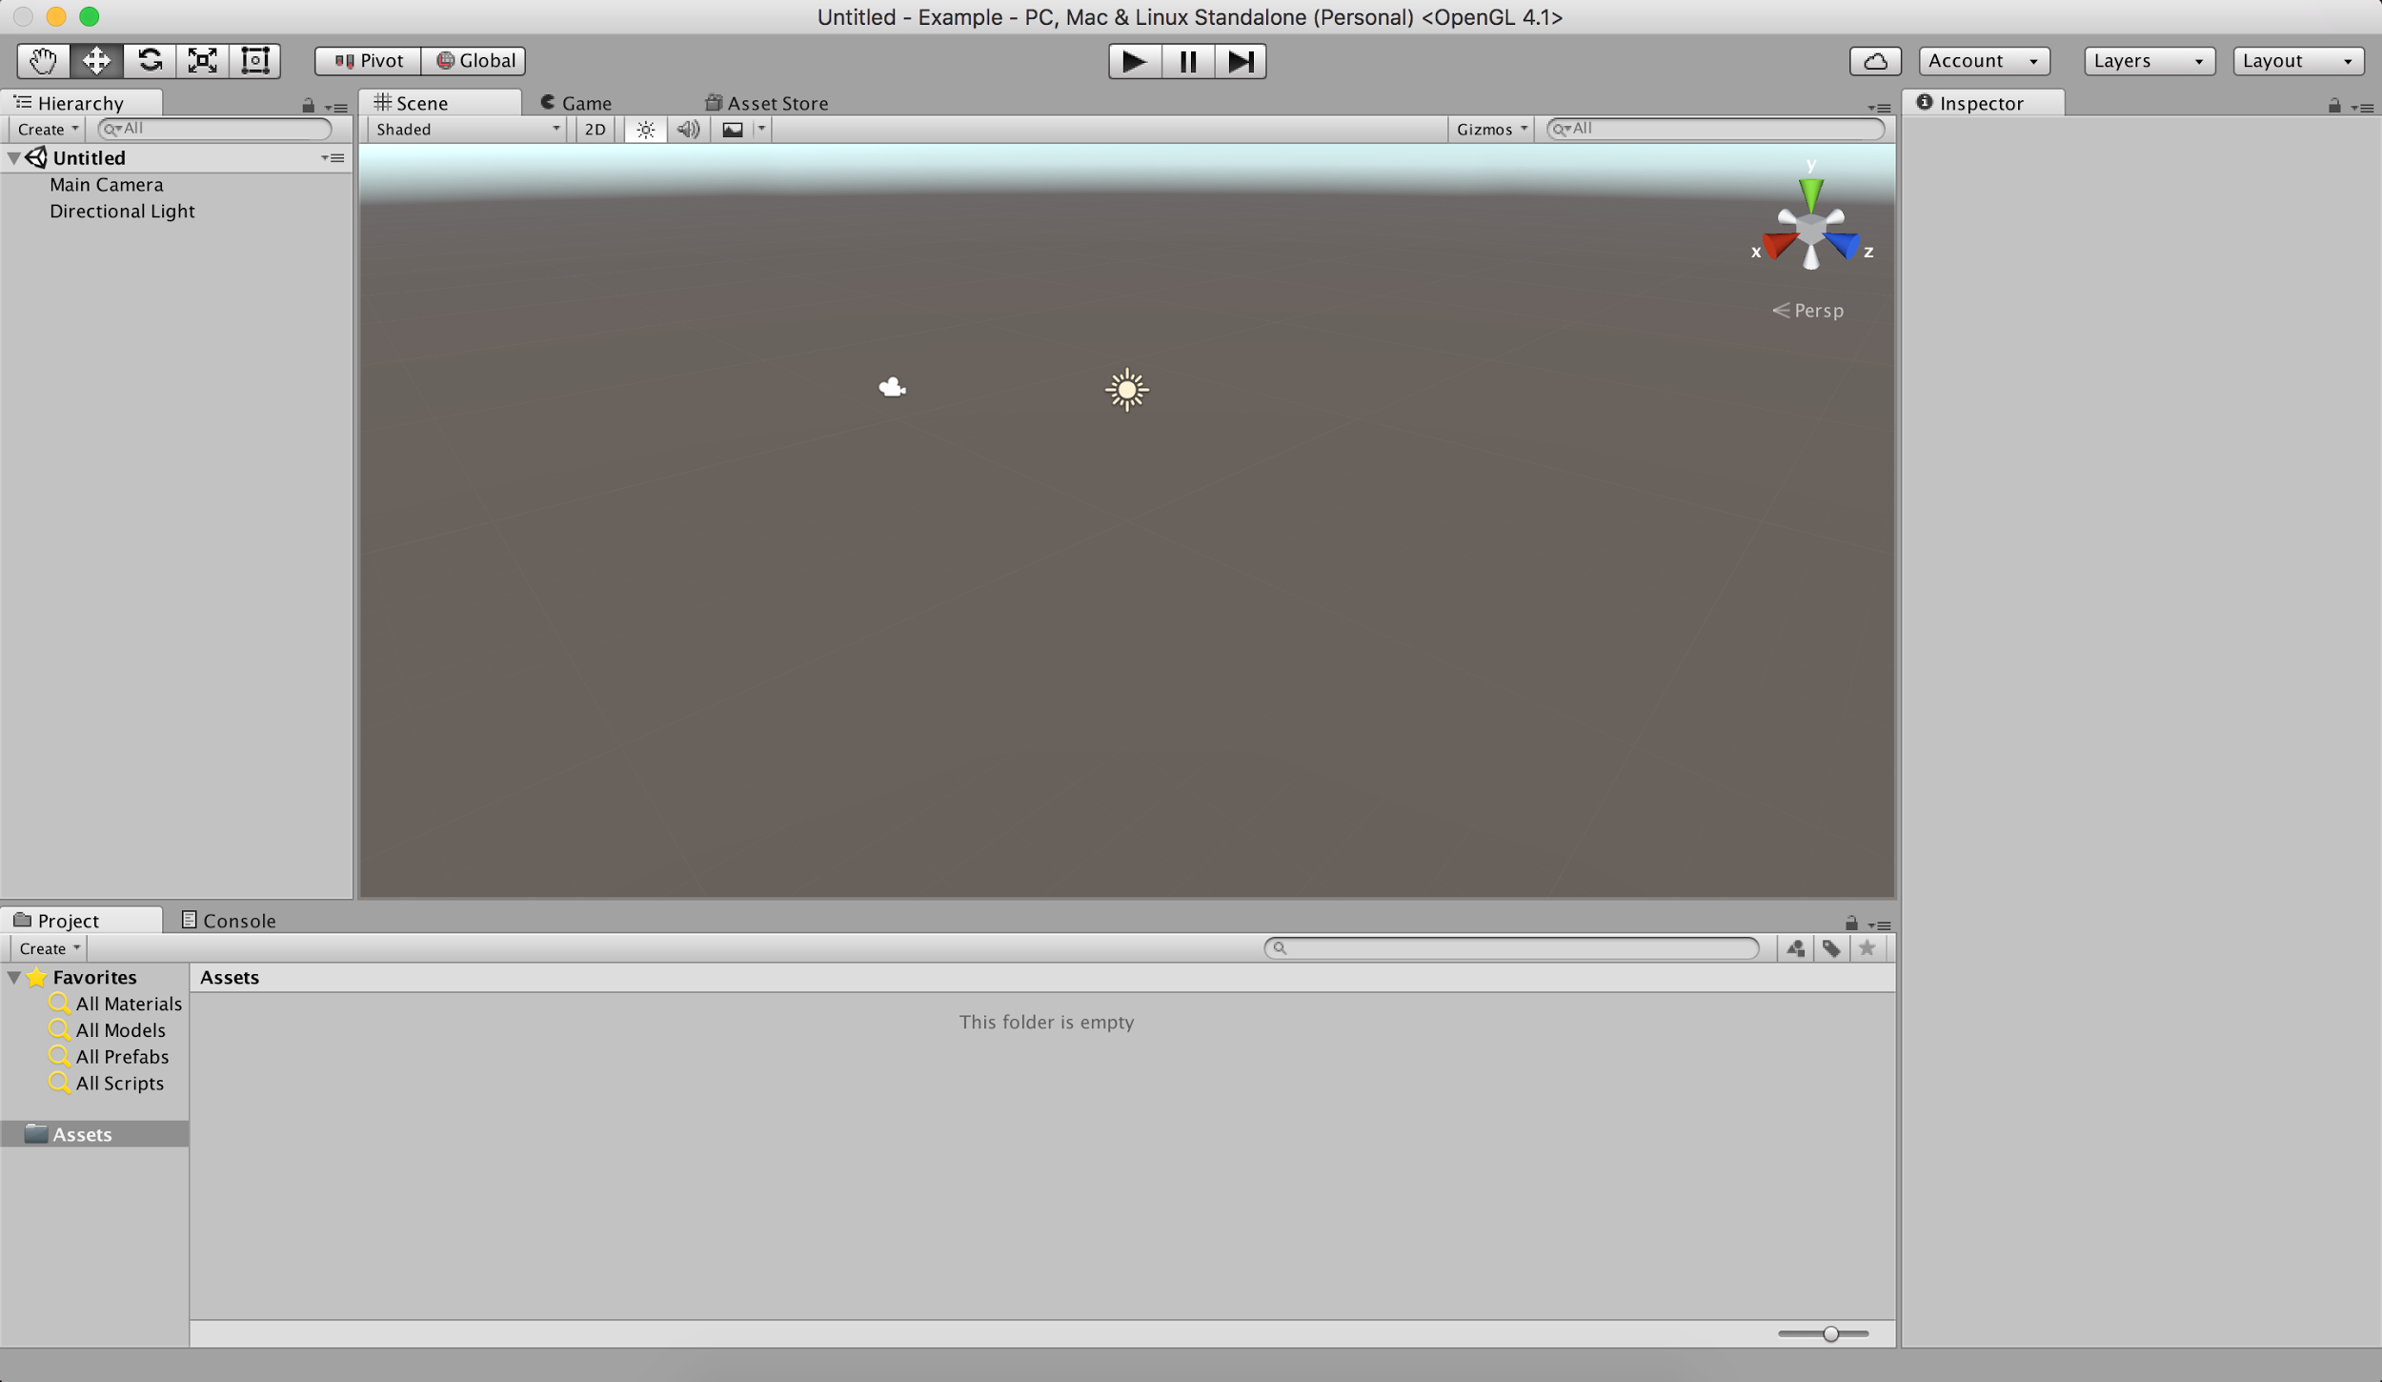
Inspector Panel
Hierarchy Panel
Scene Panel
Project Panel
Notes:
Default user interface:
The project panel is where all the assets within a project are stored. When assets are imported, they will first appear here.
The hierarchy panel is where assets are organized in a scene. Assets from the Project panel can be dragged into the hierarchy panel to add them to the current scene. The inspector panel lets you inspect and adjust all the attributes of a selected asset. Everything from its position and rotation, to whether it’s affected by gravity or able to cast a shadow. The scene panel is a 3D viewport where you can physically arrange assets by moving them around in 3D space. You can navigate the viewport by panning, rotating, and zooming the view.

Slide 13
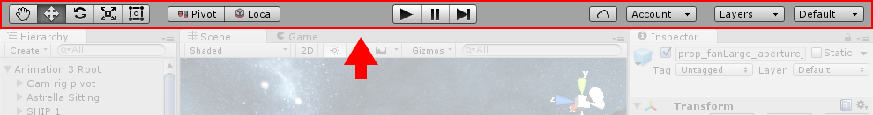
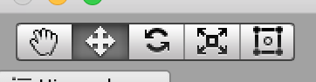
Unity’s toolbar has seven main functions.
https://docs.unity3d.com/Manual/Toolbar.html
Scene Tools
Pan, Transform, Rotate, Scale, Rect Transform
Notes:
The Rect Transform component is the 2D layout counterpart of the Transform component. Where Transform represents a single point, Rect Transform represent a rectangle that a UI element can be placed inside. If the parent of a Rect Transform is also a Rect Transform, the child Rect Transform can also specify how it should be positioned and sized relative to the parent rectangle.

Slide 14
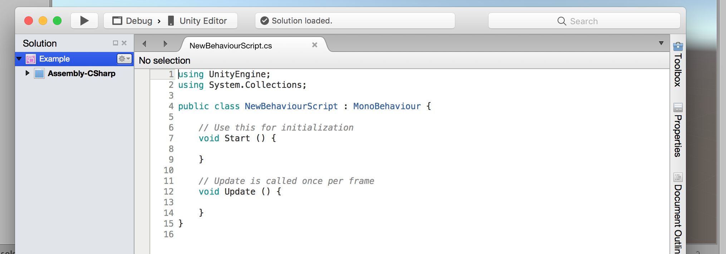
Unity offers UnityScript (which is similar to JavaScript) and C#.
Most people use C#, which is what we’ll be using as well.
Notes:
Unity used to offer support for Boo as well in previous version, but it no longer offers active support for Boo due to low users.
C# is not the same as C++ in oF. But they share similarities. (They’re both OOP).

Slide 15
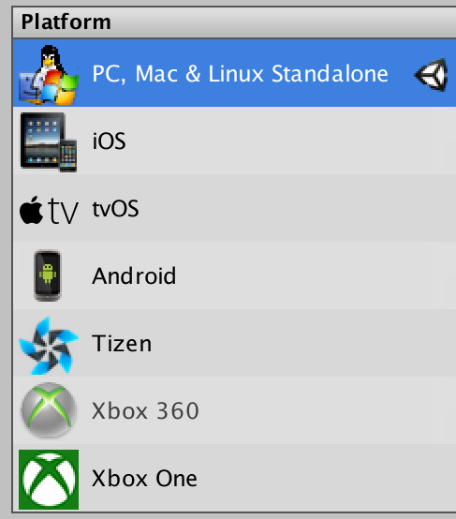
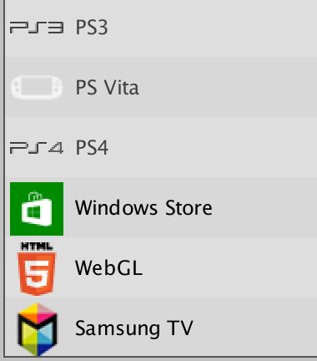
Unity is able to publish to a large variety of platforms at the push of a button.
Though some platforms will require you to install SDKs beforehand.

Slide 16
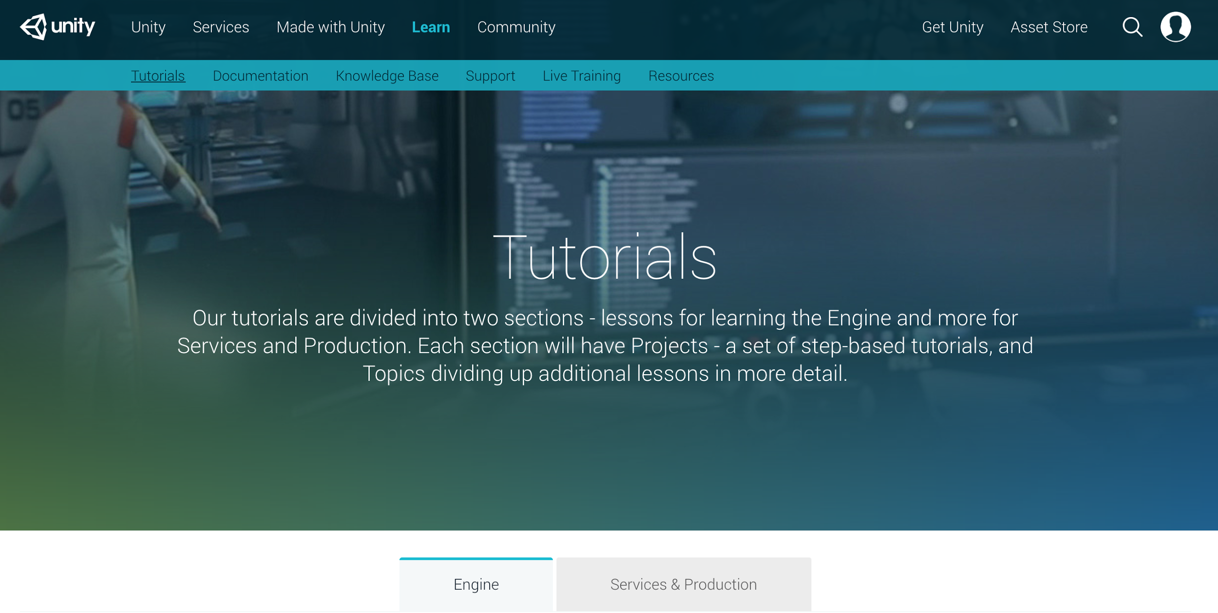
Unity has a lot of tutorials for you to get started on.
We’ll be trying out their roll-a-ball tutorial tonight.
Notes:
Unity used to offer support for Boo as well in previous version, but it no longer offers active support for Boo due to low users.
C# is not the same as C++ in oF. But they share similarities. (They’re both OOP).

Slide 17

Let’s get rolling!
Notes:
Unity used to offer support for Boo as well in previous version, but it no longer offers active support for Boo due to low users.
C# is not the same as C++ in oF. But they share similarities. (They’re both OOP).

